Slide 1
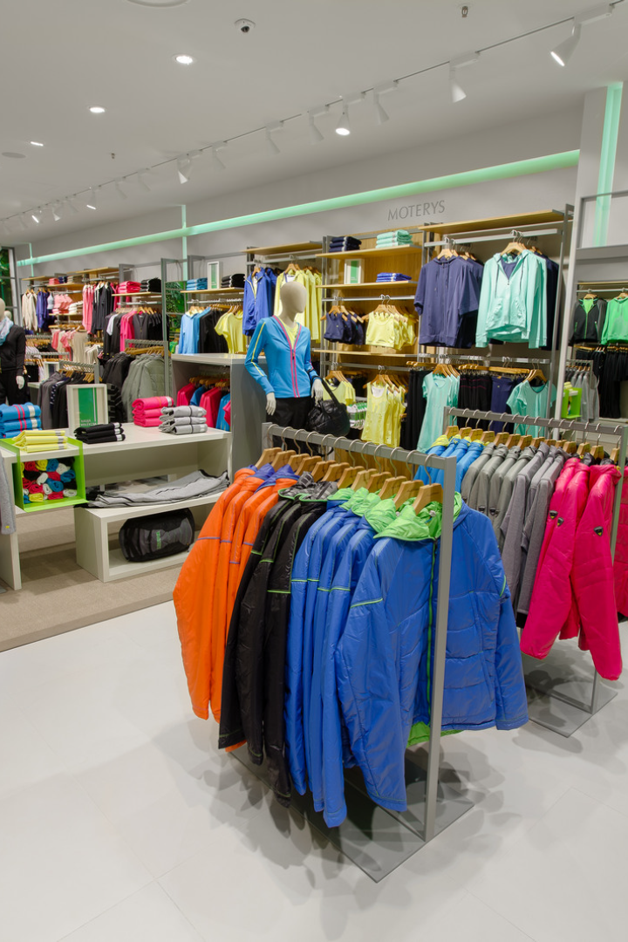

Presentation on “Retail Analysis” Capstone Project
With the right insights, retailers can boost sales, optimize inventory, and create a customized customer experience. This project aims to offer a comprehensive analysis to help retail stakeholders make data-driven decisions, targeting everything from customer preferences to product line revenue.
by Aditya Swarnakar

Slide 2













INDEX
Page 3
OBJECTIVE
Page 26-31
SALES ANALYSIS
06
Page 4-6
MECE FRAMEWORK
Page 32-38
PRODUCT ANALYSIS
07
Page 7-10
DATASET
SALES EMPLOYEE
ANALYSIS
Page 39-42
08
Page 11-13
ER DIAGRAM
Page 43
OTHER METRICS
09
Page 14-16
Page 44-51
GENERAL APPROACH
DASHBOARD
Page 17-25
Page 52-53
CUSTOMER ANALYSIS
CONCLUSION

Slide 3
The Power BI Dashboard for the Retail Database is a comprehensive and insightful tool designed to analyze various aspects of the retail business.
It focuses on following key areas:
By leveraging data from the retail database, the dashboard offers valuable visualizations and analytics to support data-driven decision-making
and strategic planning.
The objective of this project is to develop a Power BI dashboard using the Retail Database to provide comprehensive insights into the retail
business's performance. The dashboard will focus on sales, product, customer, and demographic analysis, aiming to facilitate data-driven
decision-making, optimize sales strategies, and enhance customer experiences. The goal is to empower retail stakeholders with actionable
insights, enabling them to identify top-selling products, customer preferences, and target demographics. The dashboard will offer valuable
insights and recommendations for targeted marketing, inventory optimization, and personalized customer experiences.
The final deliverables will include a report and presentation showcasing the dashboard's findings and significance, serving as a powerful tool for
retail stakeholders to improve business strategies and achieve success in the competitive retail market.
OBJECTIVE OF THE PROJECT
Sales Analysis
Product Analysis
Customer Analysis
Demographic Analysis
Comprehensive Retail Insights
Actionable Analytics
Enhanced Customer Engagement
Data-Driven Marketing Strategies

Slide 4
MECE FRAMEWORK
SALES ANALYSIS | Top-Selling Products: Identification of the products with the highest sales volume and revenue
 | Sales Trends : Tracking sales patterns over time to identify seasonal trends or fluctuations
 | Most Profitable Products: Identification of product lines that drive profitability and prioritize them for marketing and inventory management
PRODUCT ANALYSIS | Product Performance: Evaluation of sales, quantity in stock, and profitability to make data-driven decisions
 | Underperforming Products: Identification of underperforming products and make necessary adjustments
 | Product Line Performance: Analyzing the performance of product lines to understand the categories that drive sales and profitability
CUSTOMER ANALYSIS | Segmentation: Segmentation of customers based on their purchasing behaviour, demographics, or geographic location to create targeted marketing campaigns
 | High-Value Customers: Identification of high-value customers and develop strategies to retain and upsell them
 | Preferences: Analyzing customer preferences to personalize marketing campaigns and improve customer experiences

Slide 5
MECE FRAMEWORK
DEMOGRAPHIC ANALYSIS | Understanding Customer Demographics: Understanding the distribution of customers across different demographics like age, gender, and location
 | Targeted Marketing Campaigns: Identification of target demographics for specific products or marketing campaigns
 | Evaluate Marketing Effectiveness: Evaluating the effectiveness of marketing efforts in reaching and engaging different demographic groups
INVENTORY ANALYSIS | Optimizing Inventory Levels: Analyzation of product demand and sales patterns to optimize inventory levels
 | Identification Slow-Moving or Overstocked Products: Take appropriate actions such as offering promotions or adjusting procurement for slow-moving or overstocked products
MARKETING ANALYSIS | Evaluating Campaigns: Evaluating the effectiveness of marketing campaigns by analyzing sales uplift and customer response
 | Allocation of Resources: Identification of the most successful marketing channels and allocate resources accordingly
 | Tailored Messages: Using customer segmentation data to tailor marketing messages and offers to specific customer groups

Slide 6
MECE FRAMEWORK
SUMMARY:
By analyzing data on sales, customers, demographics, inventory, and marketing, retailers can gain insights into their performance and optimize their strategies accordingly. This leads to increased sales, profitability, and customer satisfaction.

Slide 7
The retail dataset provided contains valuable information about a retail company, capturing various aspects of its operations. This dataset is
essential for understanding and analyzing the company's offices, employees, customers, products, product lines, orders, order details and
payments. It contains 7 nos. of dimension tables & 1 no. junction table.
DATASET DESCRIPTION
Table Name | Field/Variable Name | Description
Offices | OfficeCode | Unique identifier for each office (Primary Key)
 | City | City where the office is located
 | PhoneNumber | Contact phone number for the office
 | Address | Street address of the office
 | State | State where the office is located
 | Country | Country where the office is located
 | PostalCode | Postal code of the office's location
 | Territory | Territory associated with the office
Employees | EmployeeNumber | Unique identifier for each employee (Primary Key)
 | LastName | Last name of the employee
 | FirstName | First name of the employee
 | Extension | Employee's phone extension
 | EmailAddress | Email address of the employee
 | OfficeCode | Office where the employee works (Foreign key)
 | ReportsTo | Employee number of the person to whom the employee reports
 | JobTitle | Job title of the employee

Slide 8
Table Name | Field/Variable Name | Description
Customers | CustomerNumber | Unique identifier for each customer (Primary Key)
 | CustomerName | Name of the customer
 | ContactLastName | Last name of the contact person
 | ContactFirstName | First name of the contact person
 | PhoneNumber | Contact phone number of the customer
 | Address | Street address of the customer
 | City | City where the customer is located
 | State | State where the customer is located
 | PostalCode | Postal code of the customer's location
 | Country | Country where the customer is located
 | SalesRepresentativeEmployeeNumber | Employee responsible for the customer (Foreign key)
 | CreditLimit | Credit limit for the customer
Products | ProductCode | Unique identifier for each product (Primary Key)
 | ProductName | Name of the product
 | ProductLine | Category or product line to which the product belongs (Foreign key)
 | ProductScale | Scale or size of the product
 | ProductVendor | Vendor or supplier of the product
 | ProductDescription | Description of the product
 | QuantityInStock | Quantity of the product in stock
 | BuyPrice | Purchase price of the product
 | MSRP | Manufacturer's Suggested Retail Price of the product

Slide 9
Table Name | Field/Variable Name | Description
Product Lines | ProductLineID | Unique identifier for each product line (Primary Key)
 | ProductLineName | Name of the product line or category
 | TextDescription | Description of the product line
 | HTMLDescription | Web-based content description of the product line.
 | Image (BLOB) | Visual representation of the product line (stored as a BLOB)
Orders | OrderNumber | Unique identifier for each order (Primary Key)
 | OrderDate | Date when the order was placed
 | RequiredDate | Date when the order is required to be shipped
 | ShippedDate | Date when the order was shipped
 | OrderStatus | Predefined status of the order
 | Comments | Additional comments related to the order
 | CustomerNumber | Customer who placed the order (Foreign key)
 | OfficeCode | Office where the order was placed (Foreign key)
Order Details (Junction table) | OrderNumber | Links to the order for each line item (Foreign key)
 | ProductCode | Links to the product for each line item (Foreign key)
 | QuantityOrdered | Quantity of the product ordered
 | PricePerItem | Price per item for the product
 | OrderLineNumber | Line number for each item within an order

Slide 10
Table Name | Field/Variable Name | Description
Payments | CustomerNumber | Customer making the payment (Foreign key)
 | CheckNumber | Check number associated with the payment. (Primary Key)
 | PaymentDate | Date when the payment was made
 | PaymentAmount | Amount of the payment

Slide 11
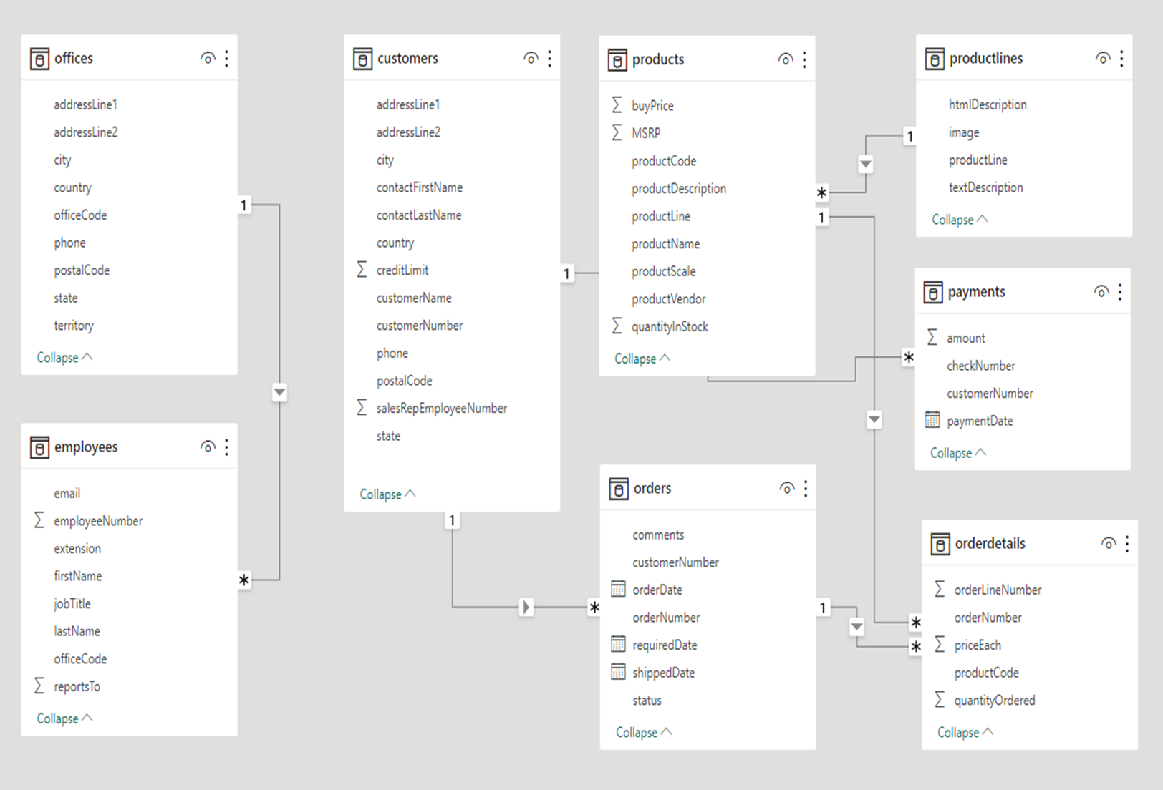
ORIGINAL ER DIAGRAM PROVIDED

Slide 12
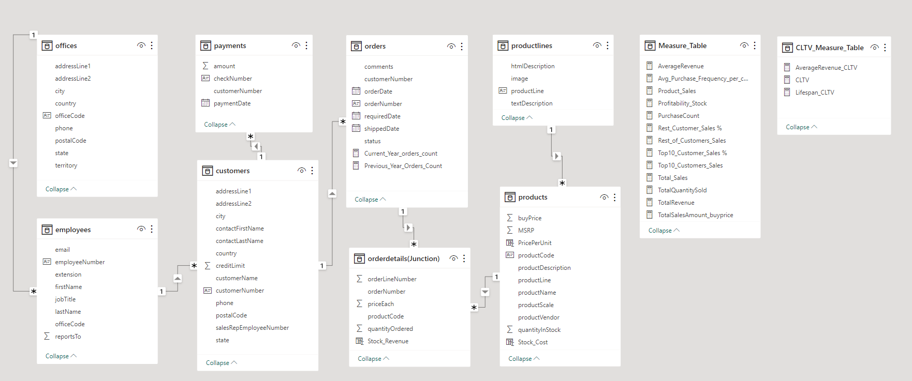
MODIFIED ER DIAGRAM FOR ANALYSIS IN POWER BI DESKTOP

Slide 13
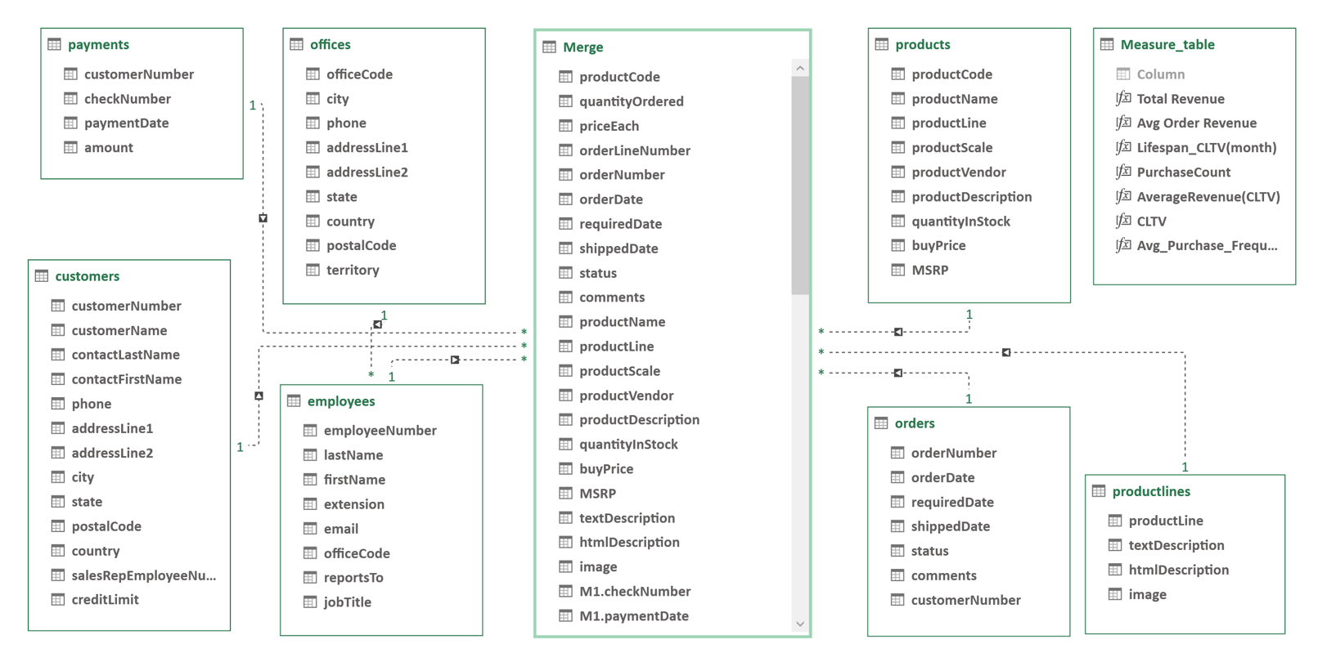
MODIFIED ER DIAGRAM FOR EXPLORATORY DATA ANALYSIS (EDA)

Slide 14
GENERAL APPROACH TO ANALYSIS
Performing analysis of the above retail dataset using Power BI Desktop and conducting exploratory data analysis (EDA) involves several steps. Below are the detailed approach through this process:
Step 1: Data Import
Used "Get Data" to import the dataset. Choosen the appropriate data source option (in CSV format) based on where dataset is stored. Connected and loaded it into Power BI Desktop.
Step 2 : Basic check & behaviour
Checked the data types, row numbers, headers, columns, column profile to understand the behaviour & attributes of various data types like null values, empty, distinct values, number of rows, identification of primary & foreign keys.
Step 3: Data Modelling
In the Power BI Desktop, modified the Entity Relationship (ER) Diagram & create a single data model table by defining relationships between individual tables. The primary relationships will typically involve keys like order number, customer number, employee number, product code etc.
Created relationships correctly to enable meaningful analysis. Used joins (merge option) between all tables while ensuring no data loss occurs as far as possible. After joining the tables, a final table formed which contains all unique variables (in columns) from all tables to maintain data integrity & minimise redundancy.
Step 4: Data Cleansing and Transformation
Performed data cleansing and transformation as needed. This involved row header formatting, data type formatting (if any).
Used the Power Query Editor to make these transformations.

Slide 15
Step 5: Basic Data Exploration
Created initial visualizations to explore the data. Started with simple charts like bar charts, line charts, and tables to understand the distribution of data in each table. Identified key metrics and KPIs for tracking.
Step 6: Advanced Visualizations
Analyzation of medium complexity visualizations based on goals. Power BI offers various visualization types, including scatter plots, pie charts, maps, and custom visuals.
Used slicers, filters, and drill-through options to allow users to interact with the data and explore it further.
Step 7: Aggregations and Summarizations
Created summary tables and matrices to display aggregated information. Calculated totals, averages, and other summary statistics for different dimensions of your data.
Use DAX (Data Analysis Expressions) to create calculated columns and measures for these aggregations.
Step 8: Time-Series Analysis
Created time-based (for dates) visualizations such as time series charts, averages or seasonal analysis.
Use date hierarchies and time intelligence functions in DAX to analyze time-based trends.

Slide 16
Step 9: Insights and Storytelling
Developed insights from data analysis & prepared various dashboards. Identified trends, outliers, and patterns in the data.
Created a compelling data story by arranging visualizations into a cohesive report or dashboard. Added titles, descriptions, and annotations to explain the findings.

Slide 17

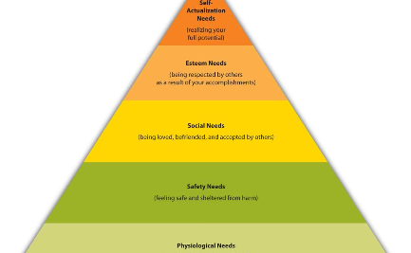

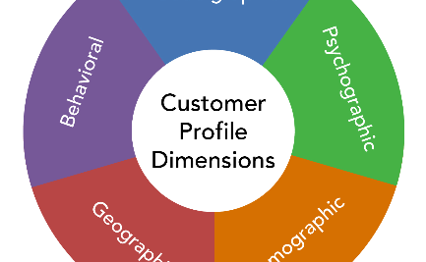
CUSTOMER ANALYSIS
Consumer Insights and Engagement
Top customer preferences and tendencies
Loyal Customer Engagement Metrics
Target Demographics and Locations
Tracking how customers interact with the brand and identify any patterns in their purchasing behaviors. Using this data to build a loyalty program or create personalized customer experiences.
Identifying patterns or key metrics within your most loyal customers. Using these insights to help shape your marketing approach and create targeted campaigns that will resonate with this group.
Understanding the regions and demographic profiles that your retail business targets. Using this data to target your marketing efforts to these specific groups.

Slide 18
Payments and Customer Purchase Behavior
1
Payment Trends
Tracking payment trends and identify patterns in payment options chosen by customers for Sales data.
Monitoring Abandoned Carts
2
Shows how often customers abandon their carts, and identify possible improvements in the checkout process.
3
Customer Purchase Behavior
Understand how often customers make purchases over time and identify trends or seasonality that can help us plan marketing promotions/campaigns.

Slide 19

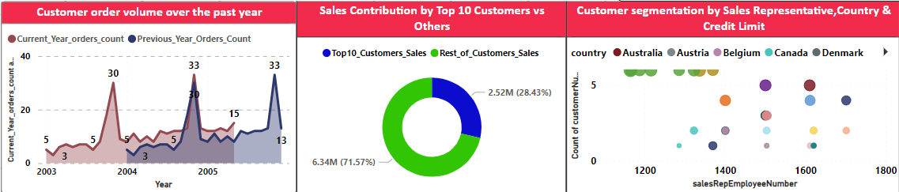
VISUALIZATIONS WITH INSIGHTS
CUSTOMER ANALYSIS
(PART 1 OF 7)
Area Volume Chart:
﻿Current Year orders count (200.00% increase) and Previous Year Orders Count (160.00% increase) both trended up between January 2003 and December 2005.﻿﻿
﻿﻿Previous Year Orders Count started trending up on July 2005, rising by 18.18% in 5 months.﻿﻿
﻿﻿﻿Previous Year Orders Count jumped from 11 to 13 during its steepest incline between July 2005 and December 2005.﻿﻿
Pie-Chart:
Shows the Sales performance of top customers compare to the rest in the form of Pie-Chart showing the value & percentage. Used “Top N” DAX function and total sales.
Scatter plot :
It has the highest Count of customer Number (10) and 1165 had the highest Sum of credit Limit (602600). The country with the highest Count of customer Number was Germany and the country with the highest Sum of credit Limit was USA.﻿﻿
﻿﻿﻿﻿Most Sales Rep. Employee Number were below 3 in Count of customer Number and below 201327 in Sum of credit Limit.﻿﻿﻿﻿

Slide 20
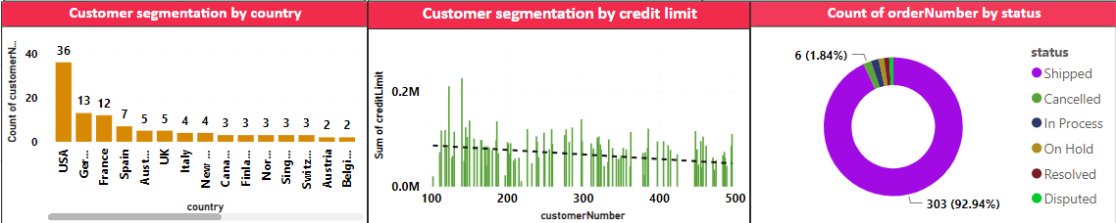
VISUALIZATIONS WITH INSIGHTS
CUSTOMER ANALYSIS
(PART 2 OF 7)
﻿﻿﻿Column Chart :
Count of customer number was highest for USA at 36, followed by Germany and France.﻿﻿ ﻿﻿ ﻿﻿USA accounted for 29.51% of Count of customer number.﻿﻿ ﻿﻿ ﻿﻿Across all 27 country, Count of customer number ranged from 1 to 36.﻿﻿ ﻿
﻿Clustered Column Chart:
Sum of credit limit was highest for 141 at 227600, followed by 124 and 298.﻿﻿ ﻿﻿ ﻿﻿141 accounted for 2.76% of Sum of credit limit.﻿﻿ ﻿﻿ ﻿﻿Across all 122 customer number, Sum of credit limit ranged from 0 to 227600.﻿﻿ ﻿﻿ ﻿
Pie- Chart : ﻿
“Shipped” had the highest Count of order number at 303. “Disputed” had the lowest Count of order number at 3.

Slide 21
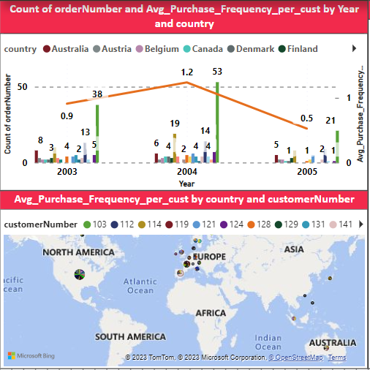
VISUALIZATIONS WITH INSIGHTS
CUSTOMER ANALYSIS
(PART 3 OF 7)
﻿Combo Chart (Line & Clustered Column Chart):
This shows the Count of order number and Average purchase frequency (shown in line) over year country-wise.
Both charts gives us insights about how customer preferences, distribution & behaviour differ based on demographic factors. By drilling this chart to city & month level. It helps in leveraging personalized marketing campaigns to cities & specific retail locations where we can identify reason for low frequency of orders across various seasons of the year & marketing head-hunt can be done to increase purchase
Map Chart : ﻿
﻿Showing overall country-wise distribution of customer’s purchase frequency. Country-Spain in customer number 141 made up 7.98% of Average Purchase Frequency. This

Slide 22
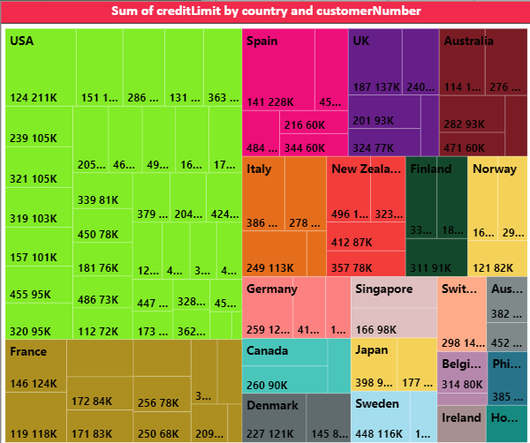
VISUALIZATIONS WITH INSIGHTS
CUSTOMER ANALYSIS
(PART 4 OF 7)
﻿Tree map:
It display hierarchical ‘Credit Limit’ Numerical values as a set of nested rectangles for each country. Each country level of the hierarchy is represented by a coloured rectangle. Each country contains smaller rectangles showing data for each customer numbers. It also illustrate the proportions between each part and the whole and reveal the measure distribution pattern across each level of categories in the hierarchy.

Slide 23
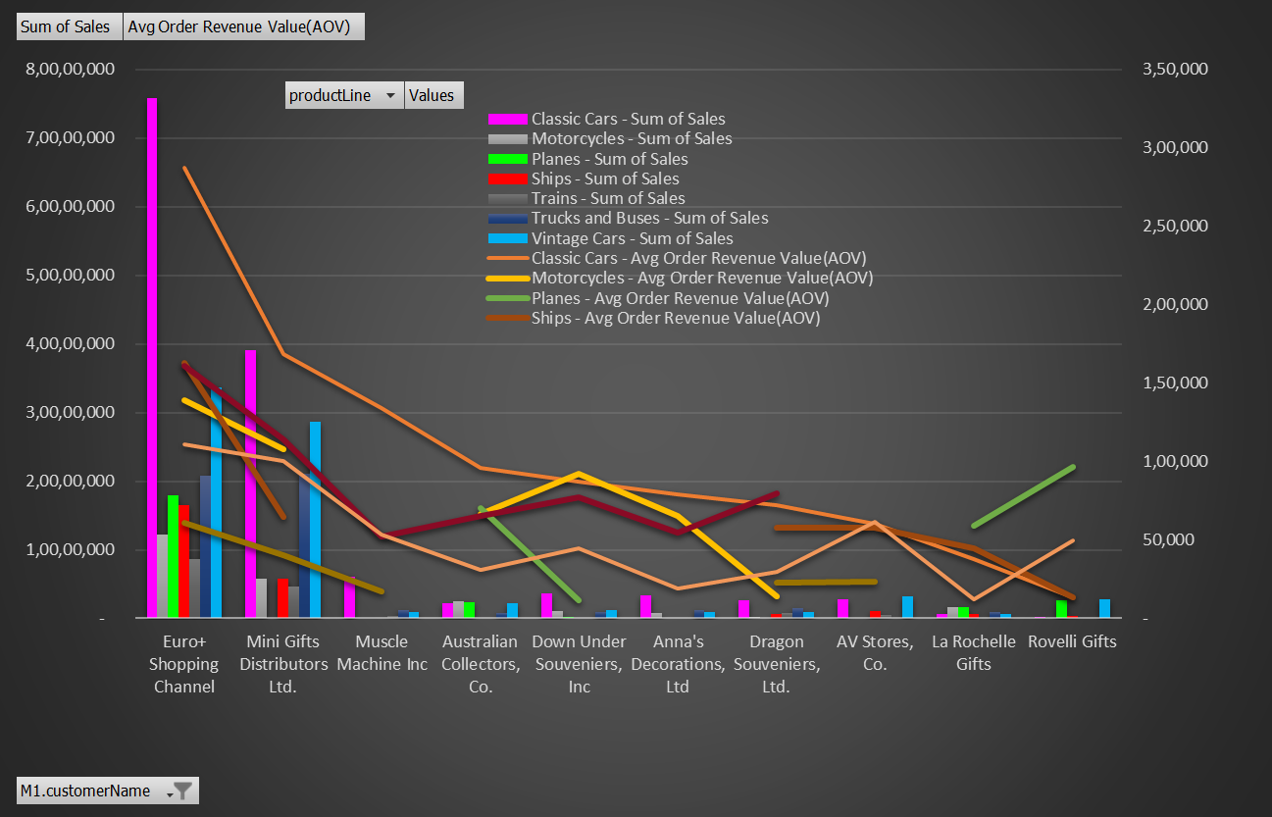
VISUALIZATIONS WITH INSIGHTS
CUSTOMER ANALYSIS
(PART 5 OF 7)
Line & Clustered column chart
[Sales & Average order value(AOV) by product line(categories)] :
Analyzing customer purchasing patterns influencing increase in average order value (AOV) shown as line.
This chart shows the total sales for each product line which can help identify which product lines are the most profitable. This information can be used to prioritize cross-selling and upselling efforts for these product lines. This information can be used to adjust pricing strategies analyzing promotions, discounts, shopping experience, product review etc. to increase AOV.

Slide 24
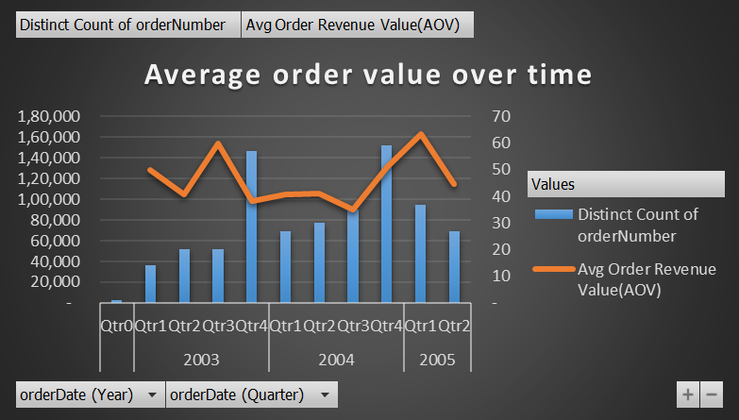
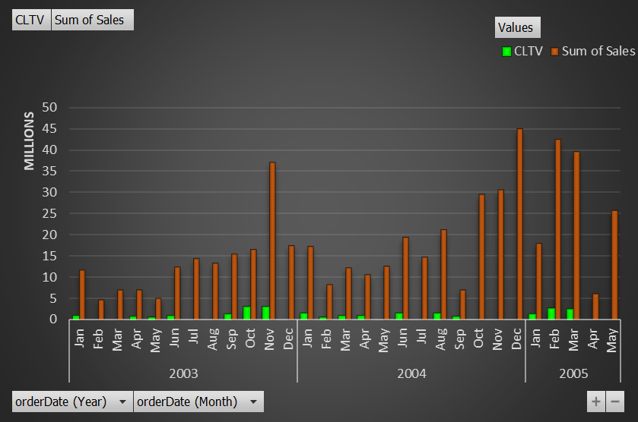
VISUALIZATIONS WITH INSIGHTS
CUSTOMER ANALYSIS
(PART 6 OF 7)
Line & clustered column chart
(AOV trend over time) :
This chart shows how the AOV has changed over time, which can help identify trends and patterns in customer purchasing behaviour. This information can be used to adjust pricing strategies or promotions to increase average order value. The calculation for this chart would involve dividing the total revenue by the number of orders during each time period.
Clustered column chart :
[ Customer Lifetime Value (CLTV) Trend over time ]
CLTV is a crucial metric used for implementing strategy for any retail business for determining High Value Customers. It helps in identifying their characteristics and how can similar customers be targeted for acquisition. CLTV helps in identifying increase in purchase frequency, purchase amount, loyalty, credit limit, Sales Representative, We can do customer segmentation, data mining, predictive analytics,

Slide 25
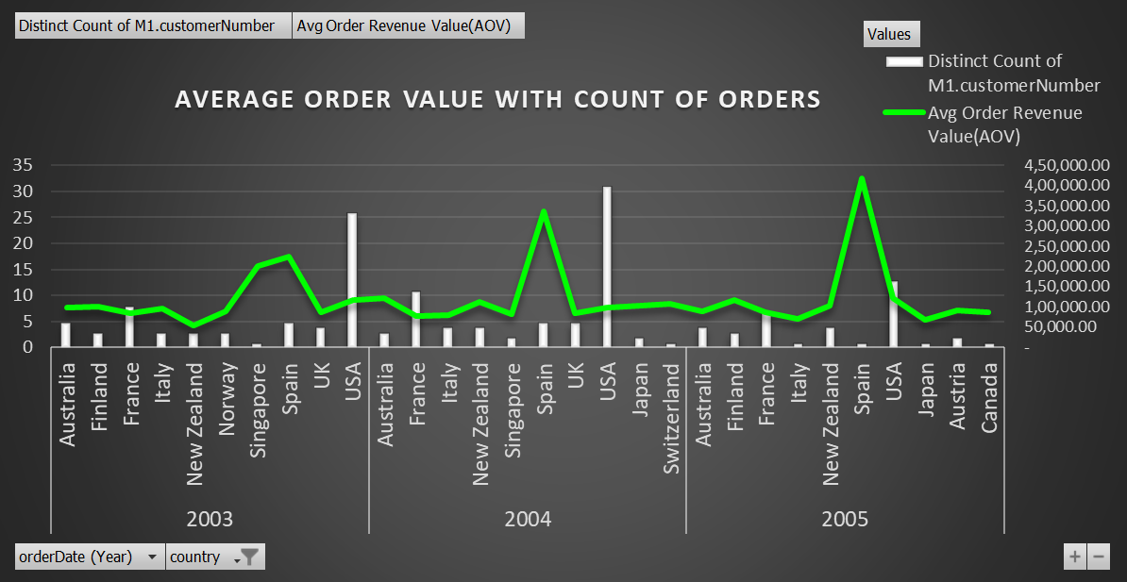
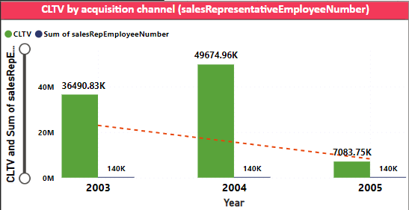
VISUALIZATIONS WITH INSIGHTS
CUSTOMER ANALYSIS
(PART 7 OF 7)
Clustered column chart with trendline:
[ Customer Lifetime Value (CLTV) vs acquisition channel (direct approach by Sales Representative ]
﻿It shows variation for different customer acquisition channels Customer Lifetime Value (CLTV)
CLTV trended down (80.59% decrease) while Sum of Rep. Employee Number remained relatively constant between 2003 and 2005.﻿﻿
﻿﻿CLTV started trending down on 2003, falling by 80.59% (2,94,07,085.45) in 2 years.﻿﻿
﻿﻿CLTV value shows steepest decline from 2004 to 2005
Line & clustered column chart : AOV (Average order revenue) in line vs distinct count of customers country-wise & year-wise
Showing AOV which is a characteristics of high-value customers
Insights : Customer Behaviour Analysis, Marketing Effectiveness, Inventory Management, Pricing and Product Strategy, CLTV

Slide 26


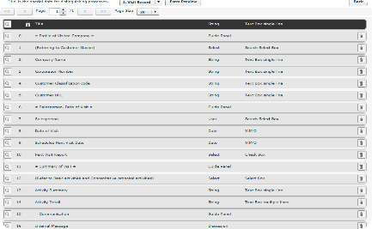


SALES ANALYSIS
Tracking Sales by Product Category
Monthly Revenue by Product Category
Yearly Order Volume Trend
Sales Contribution by Top Customers Vs. Others
Understanding how monthly revenue changes across different product categories. Use this data to determine which product categories deserve more attention in marketing and which may be underpriced.
Track how customer order volume changes over the past year. Look for trends in seasonality or changes in customer behaviors and adjust sales efforts accordingly.
Determining how much of your overall sales come from top customers versus others. Identify which customer segments are contributing the most and which should be targeted for increased attention.

Slide 27
Product Sales Across Product Lines
1
Product Line Distribution
Shown how product sales are distributed across different product lines.
Top-selling Products by Product Category
2
Shown which products are the top-sellers within each unique product category.
3
Product Performance over Time
Tracking how product sales, pricing, and stock change for each unique product category over time. Use this data to identify patterns or adjust pricing strategies as needed.

Slide 28
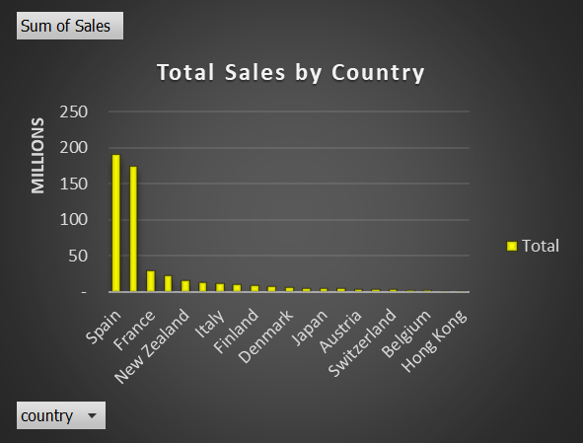
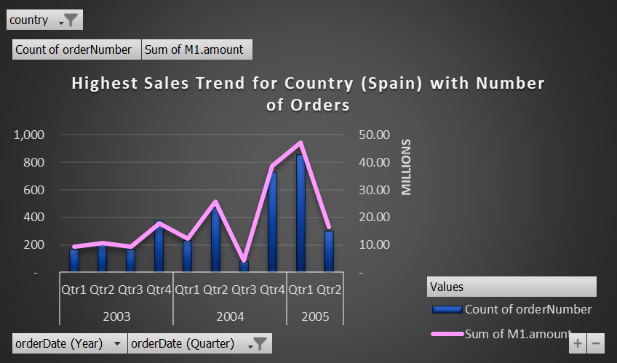
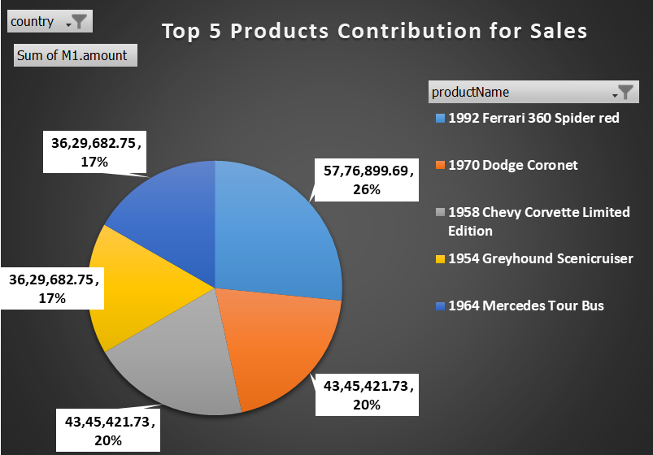
VISUALIZATIONS WITH INSIGHTS
SALES ANALYSIS
(PART 1 OF 4)
Column Chart, Line & clustered Chart and Pie-chart: -
Analyzing Sales Revenue (SR)
﻿Top regions in terms of sales revenue values (descending order).
This helps in further exploring top 5 products contribution of SR over region which if drill down will give the factors responsible.
It shows SR trends over time which shows how many number of orders have been placed by different customers which can further drill down to show details of order number, customer number, ordering behaviour, customer name, customer’s key contact person etc.

Slide 29
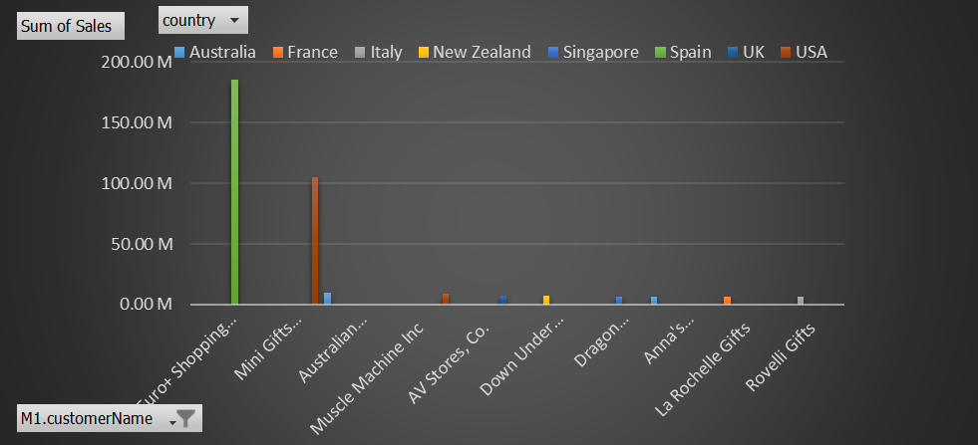
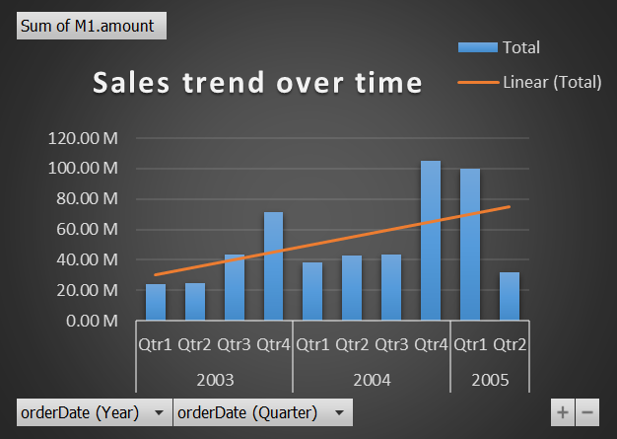
VISUALIZATIONS WITH INSIGHTS
SALES ANALYSIS
(PART 2 OF 4)
Column Chart:
Shows Sales data across countries & different customers (customer demographics)
Shows which customer segments are most profitable and which ones may require targeted marketing efforts
Insights gained from the pivot chart to take informed strategic decision-making
Column Chart:
Shows Sales data trend over time
Yearly data identify trends and patterns in sales growth.

Slide 30
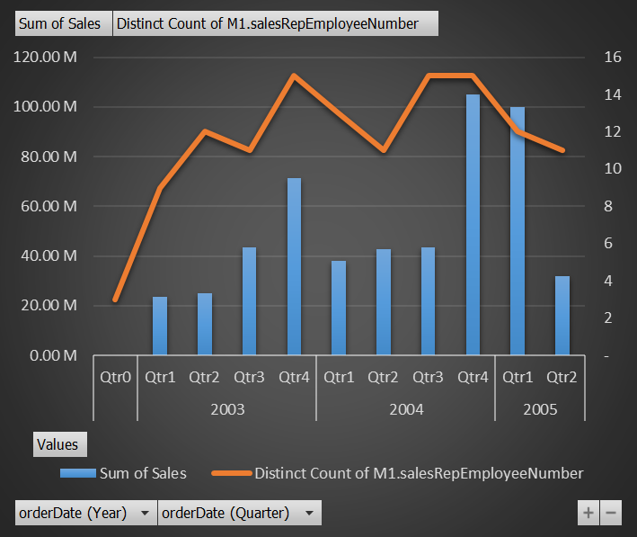
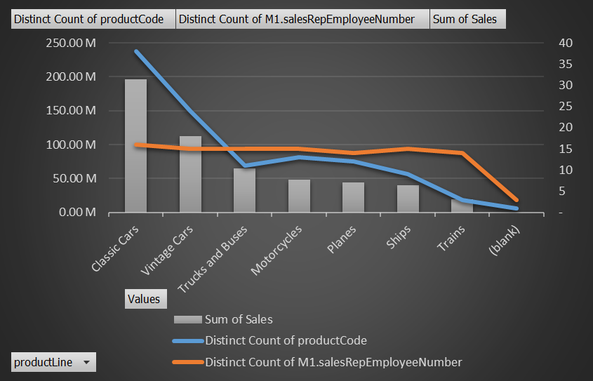
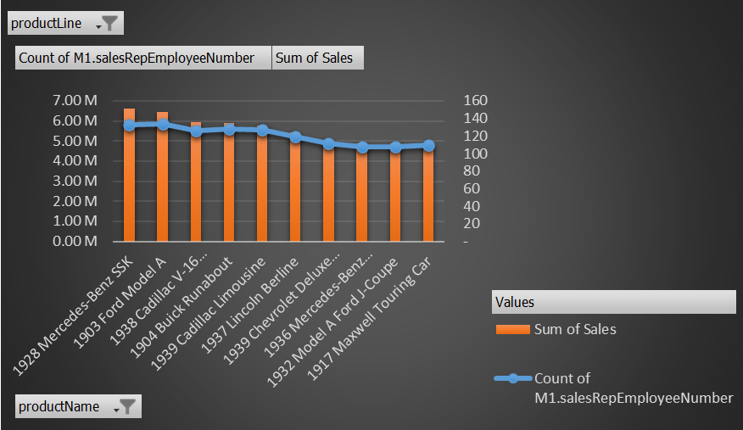
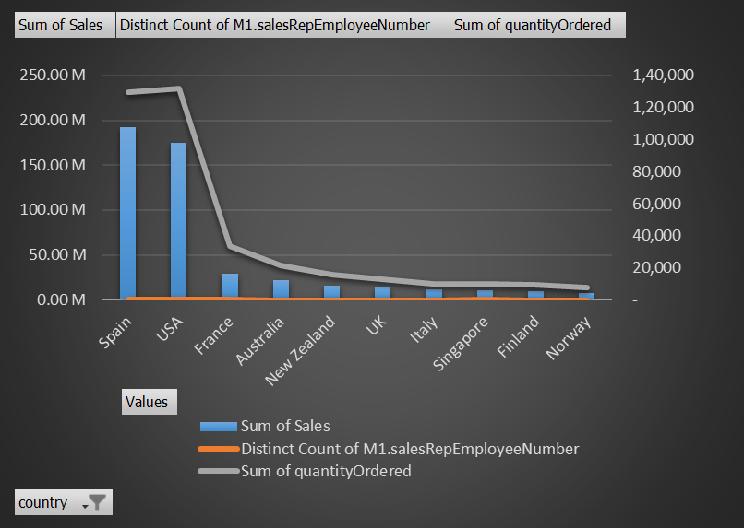
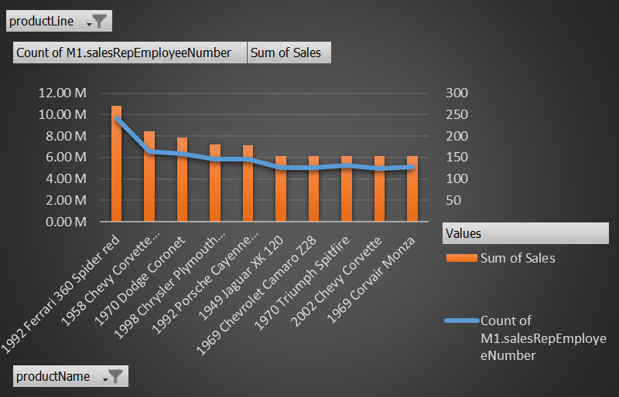
VISUALIZATIONS WITH INSIGHTS
SALES ANALYSIS
(PART 3 OF 4)
Line & Clustered Column Charts (various types):
Contribution of Sales by Company’s Sales Representative (CSR)
Shows Contribution of Sales over time
Top 10 Sales Representative Contributors for Sales by Countries
CSR contribution for Sales over product lines & Numbers (Count) of Product dealt, also "Highest Sales" over 2 nos. Specific product lines & Products
Representative Sales over Customers, numbers (Count) of Orders & Quantity ordered

Slide 31
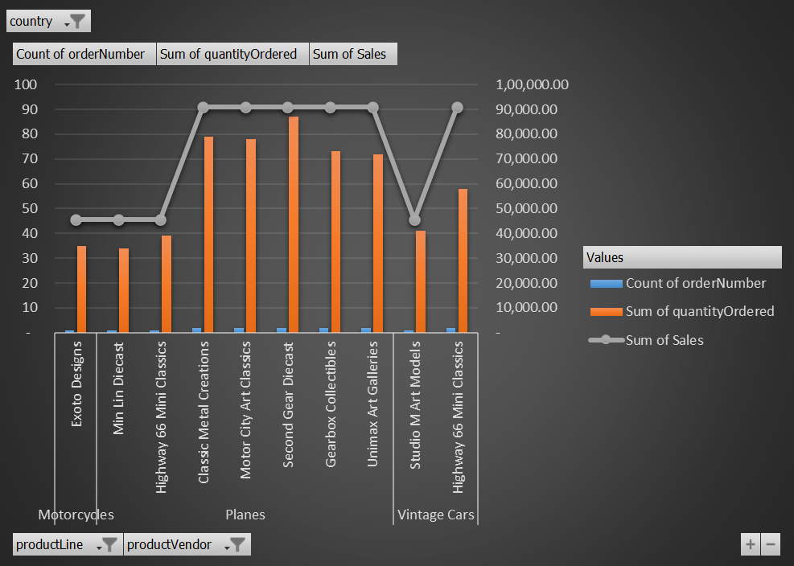
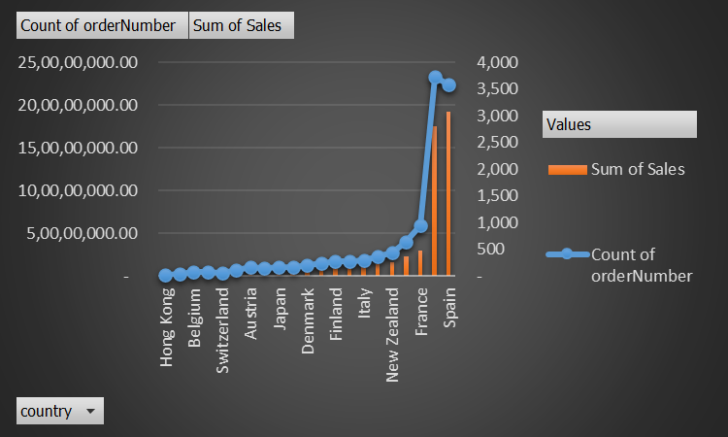
VISUALIZATIONS WITH INSIGHTS
SALES ANALYSIS
(PART 4 OF 4)
Line & Clustered Column Chart:
Sales analysis with count of order numbers, quantity ordered & country
By this marketing strategies be tailored to target specific demographic segments in different regions
Identification of the locations of retail stores or vendor and analyzation of the sales data to determine which stores/vendor are performing well for where we need to focus our marketing efforts. .

Slide 32


PRODUCT ANALYSIS
Tracking Inventory and Profitability
1
Profitability by Product
2
Inventory Management
Comparison of the profitability of different products. Adjust inventory management strategies accordingly.
Monitoring of inventory levels and track how they change over time.
3
Product Mix & market demands
Analyzing the sales data for each product and product line to identify the best-performing products and product lines.
4
Data-Driven Inventory Optimization
Used data analysis to make informed decisions about when to order, how much to order, and when to reorder.

Slide 33
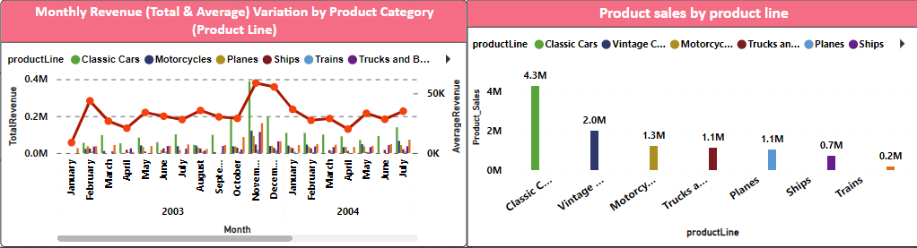
VISUALIZATIONS WITH INSIGHTS
PRODUCT ANALYSIS
(Page 1 of 6 )
Line & Clustered Column Chart:
Monthly revenue by product category over time
It shows monthly sales data of different product categories with average revenue (shown in line)
﻿The most recent Total Revenue anomaly was in November 2004, when Vintage Cars had a high of 1,83,656.60.﻿﻿
﻿﻿Total Revenue for Planes started trending down on February 2005, falling by 17.18% (6,078.00) in 3 months.﻿﻿
Column Chart:
Product Sales by product line
﻿It shows distribution of product sales across different product lines
At 42,81,695.23, Classic Cars had the highest Product Sales and was 1,966.47% higher than Trains, which had the lowest Product Sales at 2,07,198.16.﻿
﻿﻿Across all 7 product Line, Product Sales ranged from 2,07,198.16 to 42,81,695.23.﻿
﻿

Slide 34
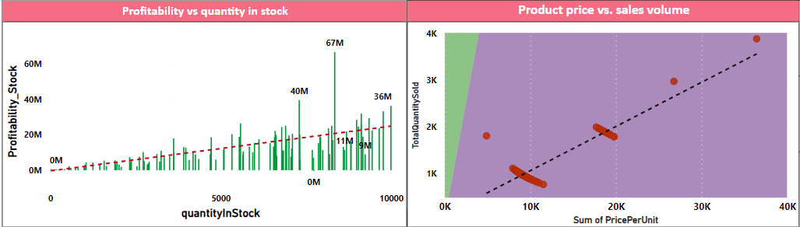
VISUALIZATIONS WITH INSIGHTS
PRODUCT ANALYSIS
(Page 2 of 6 )
Clustered Column Chart with trendline:
Analysis of Stock Quantity of different products vs profitability
﻿At 6,67,44,865.69, 8347 had the highest Profitability Stock and was 15,239.75% higher than 7733, which had the lowest Profitability Stock at -4,40,858.33.﻿
﻿﻿﻿﻿8347 accounted for 4.90% of Profitability Stock.﻿
﻿﻿Across all 110 quantity In Stock, Profitability Stock ranged from -4,40,858.33 to 6,67,44,865.69.
Scatter Plot:
Product pricing vs sales volume
It shows positive co-relation
It has the highest Sum of Price Per Unit (36,435.55) and Total Quantity Sold (3888)﻿
﻿

Slide 35
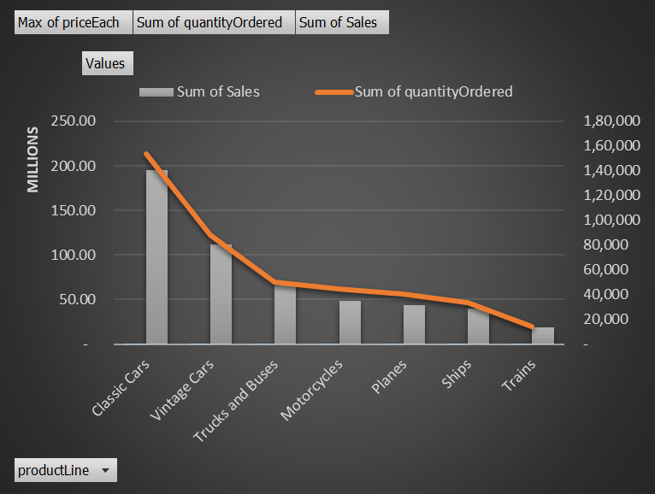
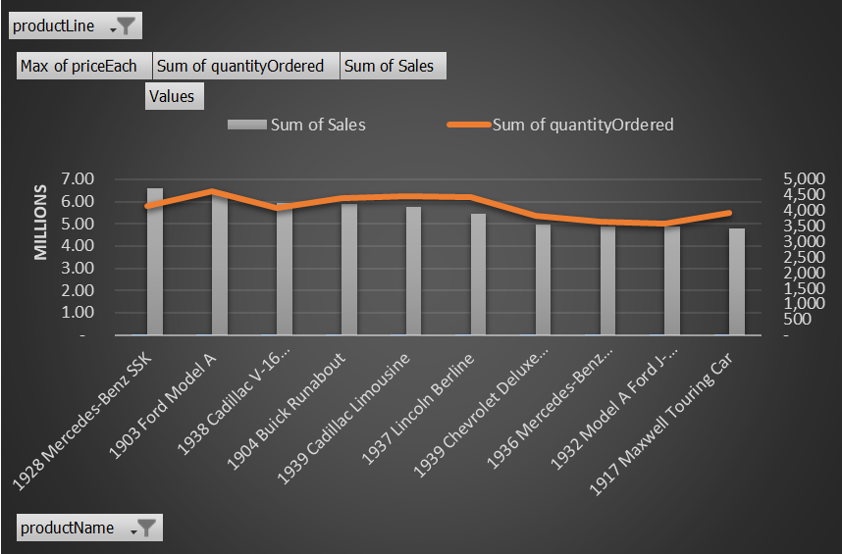
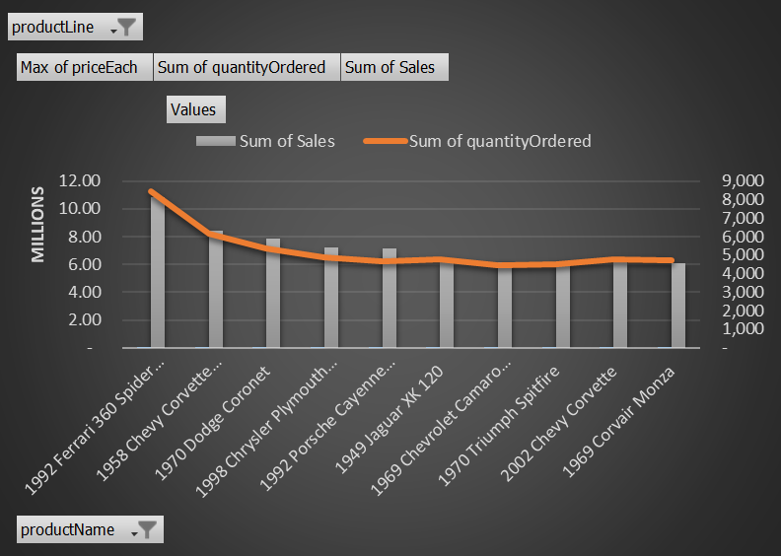
VISUALIZATIONS WITH INSIGHTS
PRODUCT ANALYSIS
(Page 3 of 6)
Line & Column Chart:
Product mix optimization for changing market demands-
Identification of the best-performing products and product line by sales data
Identified that product lines of Classic & Vintage Cars are top performing by Sales
Top 10 Product names by sales for "Classic Cars" product line only
Top 10 Product names by sales for "Vintage Cars" only

Slide 36
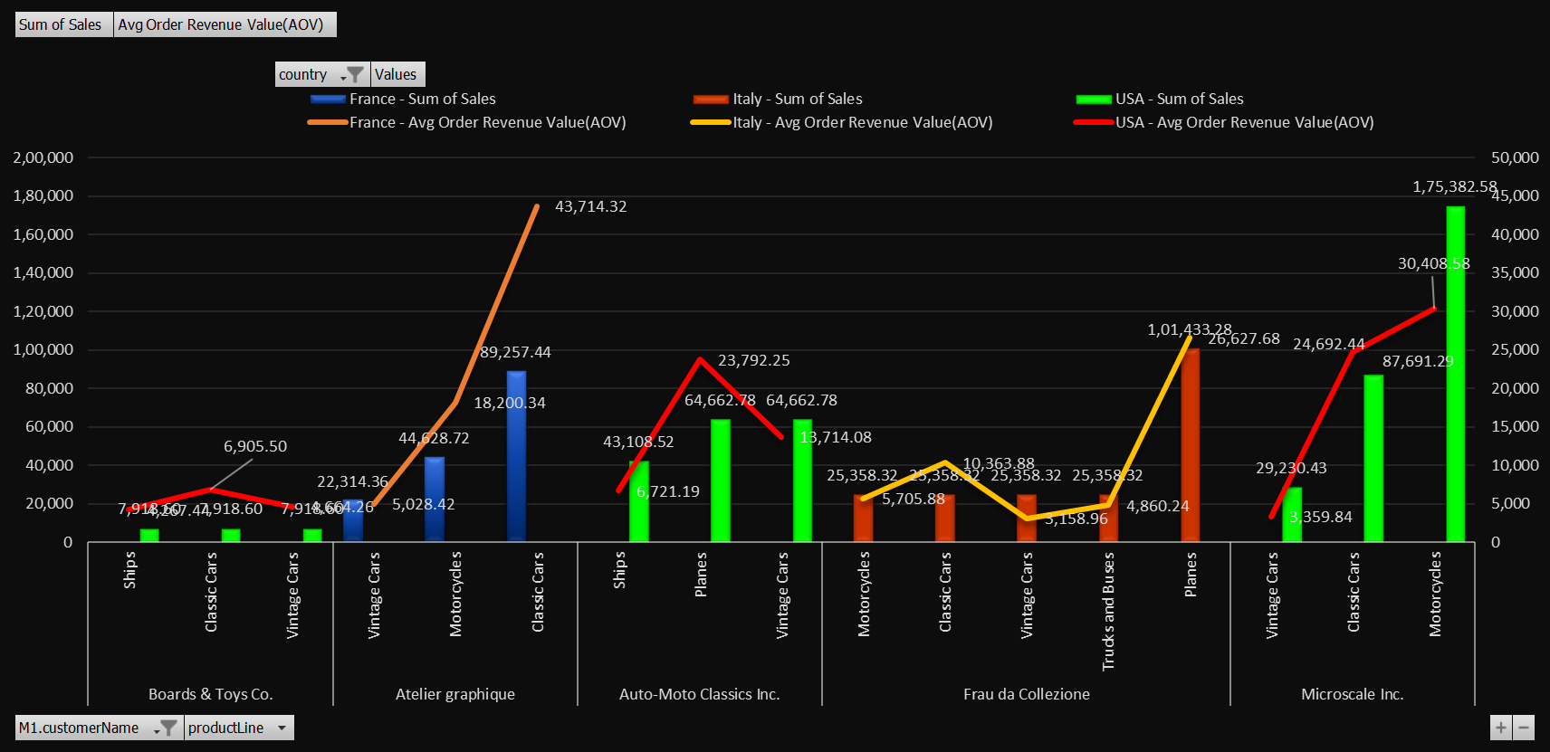
VISUALIZATIONS WITH INSIGHTS
PRODUCT ANALYSIS
(Page 4 of 6 )
Line & Clustered Column Chart:
Identification of specific market segments where a particular product is underperforming by total sales & Average Order Revenue AOV(shown as line)-
Analyzing Bottom 5 Underperforming Product lines by lowest to highest Sales with grouping of product lines under Customers with Country (market segment) (age & gender data not available in dataset)
USA has the lowest sales : marketing strategies or product offerings to better meet the needs and preferences of those customers. For example, we could create targeted marketing campaigns for specific customer demographics or adjust our product offerings to better suit their preferences

Slide 37
VISUALIZATIONS WITH INSIGHTS
PRODUCT ANALYSIS – PRICING STRATEGY
(Page 5 of 6 )
Pivot tables (for Product and Pricing Strategies Year-Wise & lowest to highest product unit price) : Identification of potential untapped markets based on demographic indicators, and how can market penetration be increased-
Demographics by credit limit amount in descending order shows “Spain” country have highest credit limit of customers.
Then arranged by product unit price (lowest to highest) for showing Bottom 10 product names, quantity ordered.
Product prices needs to be taken care for market penetration with quantity availability with focussed Credit limit of Customers
Product offerings and pricing strategies to appeal to the identified demographics. This might involve introducing products that are particularly popular in certain regions or adjusting prices to match the local market.

Slide 38
VISUALIZATIONS WITH INSIGHTS
PRODUCT ANALYSIS – PRICING STRATEGY
(Page 6 of 6)
Shown same as per previous page for 2005 year

Slide 39


SALES REPRESENTATIVE EMPLOYEE PERFORMANCE ANALYSIS
Sales Representative Insights
It analyzes sales performance and trends among our sales representatives. The insights gained will be useful for improving overall sales and identifying areas for improvement. Having a clear understanding of sales performance is essential to improving sales. In this presentation, we analyze data regarding sales representatives to provide insights into performance and areas for growth. Our dataset is relevant to sales representatives, as it provides key information on how to optimize sales efforts.
Sales Performance Metrics
They are evaluated based on several key performance metrics, including total sales, number of orders processed, average order value, and sales growth over time. These metrics provide valuable insights into how our sales representatives are performing and where there may be areas for improvement.

Slide 40
Sales by Product Line
Understanding which product lines are performing best is critical to improving overall sales. Our data shows that [insert percentage] of our sales come from [insert product line]. Other top-performing product lines include [insert product line] and [insert product line].
Customer Retention
Customer retention is key to sustained sales growth. Analyzing customer retention and repeat orders for each sales representative can help us to identify areas for improvement. We find that the average customer return rate is [insert rate], and some sales representatives have higher customer retention rates than others.

Slide 41
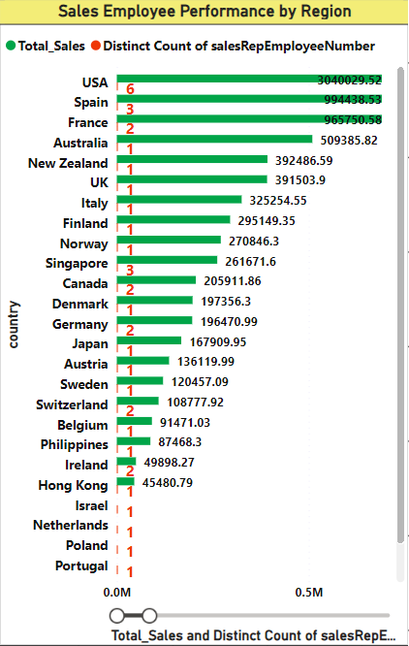
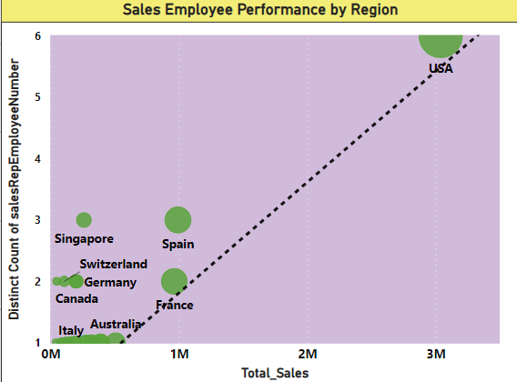
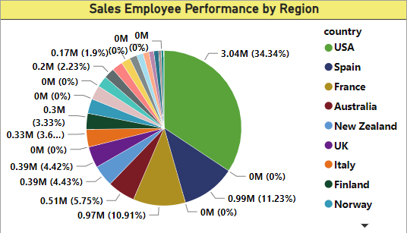
VISUALIZATIONS WITH INSIGHTS
SALES REPRESENTATIVE ANALYSIS
(Page 1 of 2)
Sales Employee (SE) performance by region:-
Bar chart (for Sales by each SE region wise)
Scatter plot: Positive correlation between Total Sales and total Count of SE Number
Pie Chart: Percentage of sales contribution
It shows both values & percentage of sales contribution & distribution by each sales employee region-wise for performance measurement
﻿USA accounted for 34.34% of Total Sales.﻿﻿
﻿At 30,40,029.52, USA had the highest Total Sales and was 6,584.21% higher than Hong Kong, which had the lowest Total Sales at 45,480.79.﻿﻿
﻿﻿﻿﻿Total Sales and Count of SE number diverged the most when the country was USA, when Total_Sales were 30,40,023.52 higher than Count of SE number.﻿

Slide 42
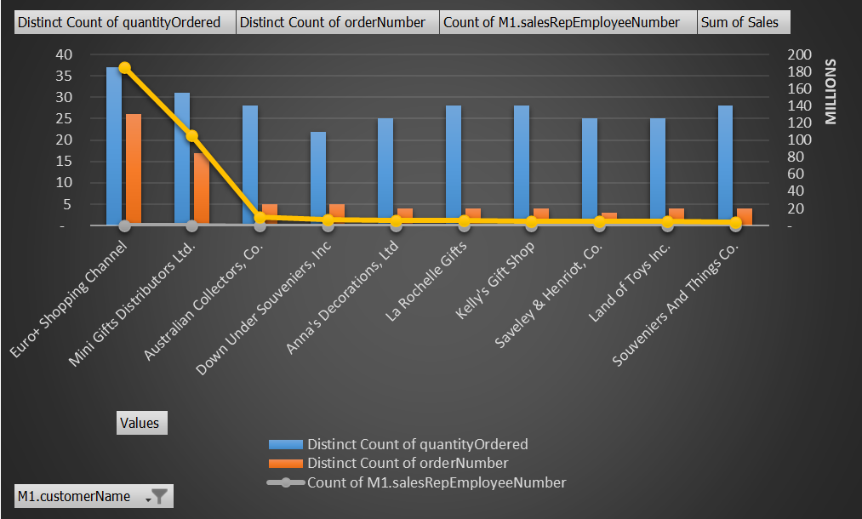
VISUALIZATIONS WITH INSIGHTS
SALES REPRESENTATIVE ANALYSIS
(Page 2 of 2)
Line & clustered column chart:
Sales Employee (SE) performance for Sales variation by region:
It shows SE responsible for Sales over Customers, Numbers (Count) of Orders & Quantity
Displaying sales data by SE to identify top-performing representatives and areas for improvement
If a specific sales representative is consistently performing well, the company can provide additional training or incentives to motivate other representatives to perform at a similar level

Slide 43
Other Business Performance Metrics Shown in
different analysis in previous slides
Sales Over Time
Store Performance Metrics
Tracking how overall retail sales perform over time and identify key growth opportunities for product lines and regions.
Monitoring different stores' overall performance and identify any patterns or opportunities for growth.
Revenue Metrics by Region
Marketing Metrics
Tracking regional retail revenue metrics and identify key regional growth opportunities.
Monitoring marketing metrics such as email open and click-through rates, social media engagement, and promotional conversion rates.

Slide 44

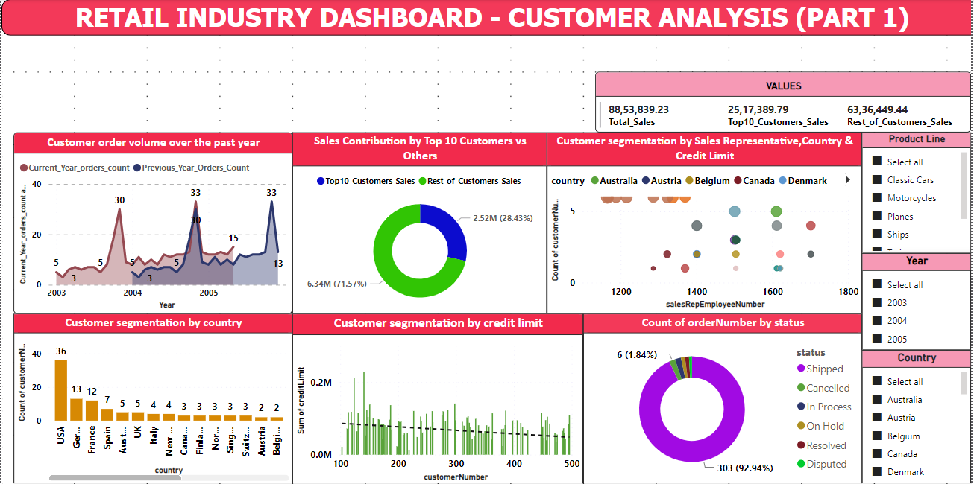
DASHBOARD (POWER BI)

Slide 45
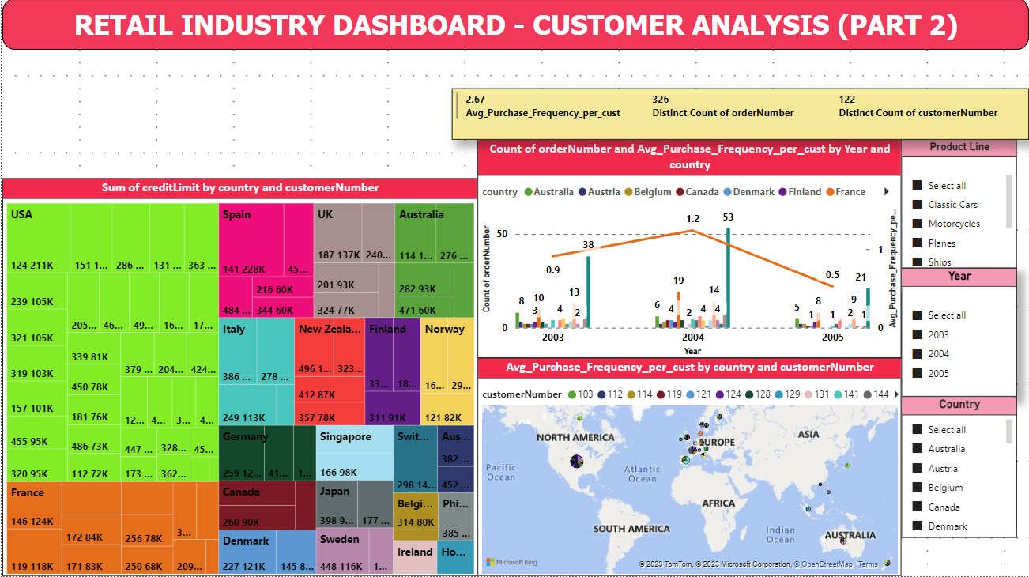
DASHBOARD (POWER BI)

Slide 46
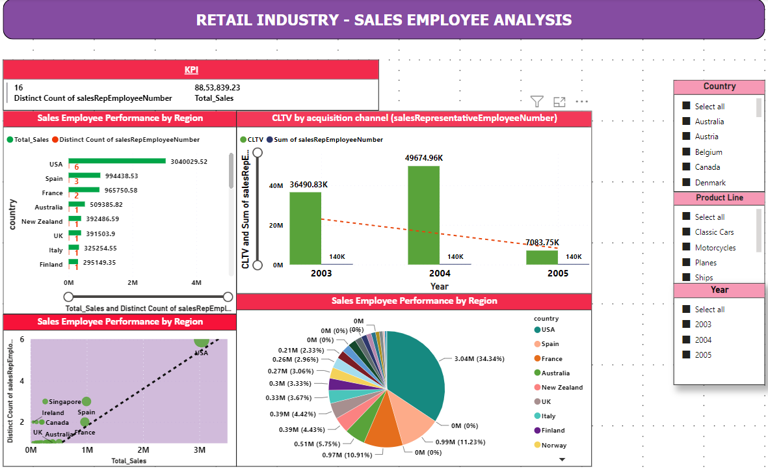
DASHBOARD (POWER BI)

Slide 47
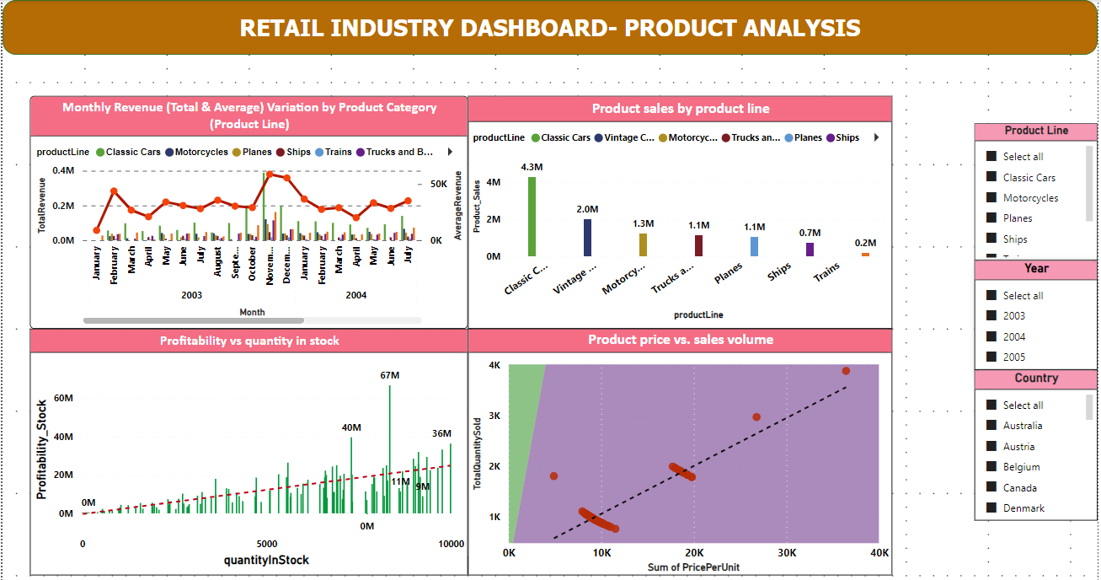
DASHBOARD (POWER BI)

Slide 48
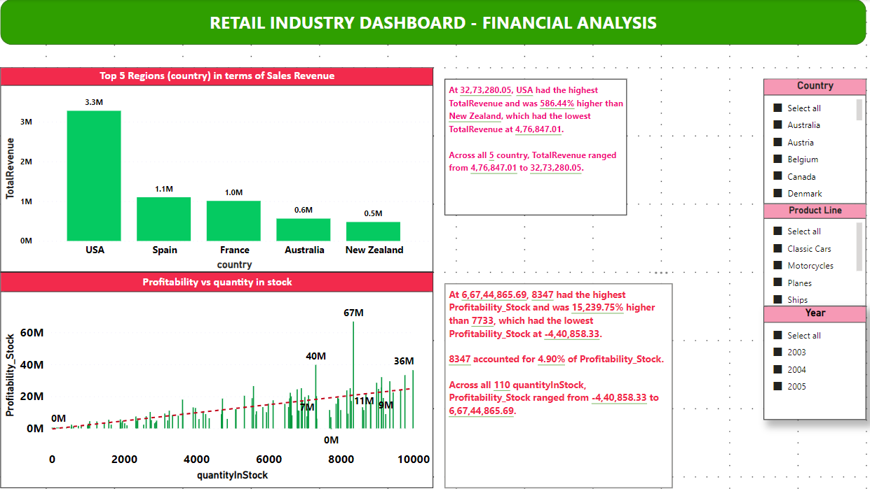
DASHBOARD (POWER BI)

Slide 49
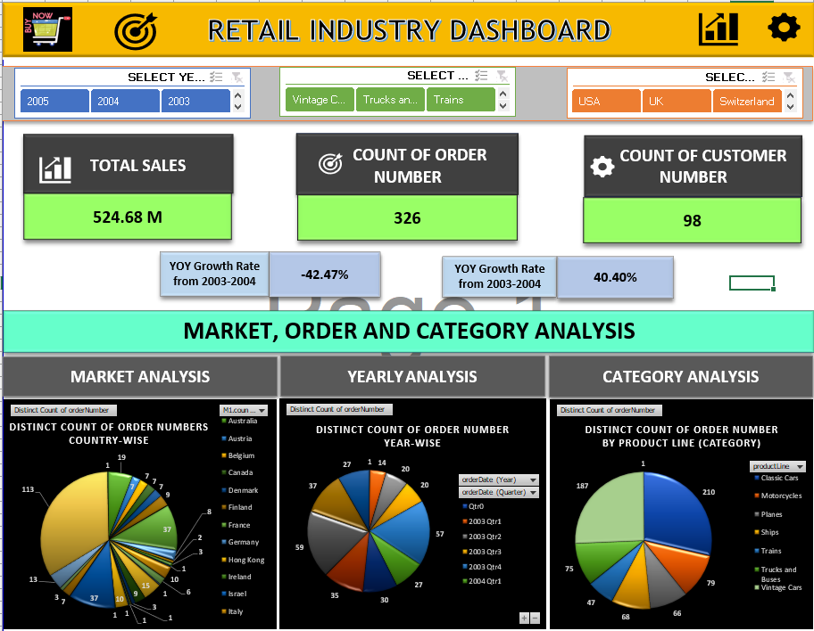
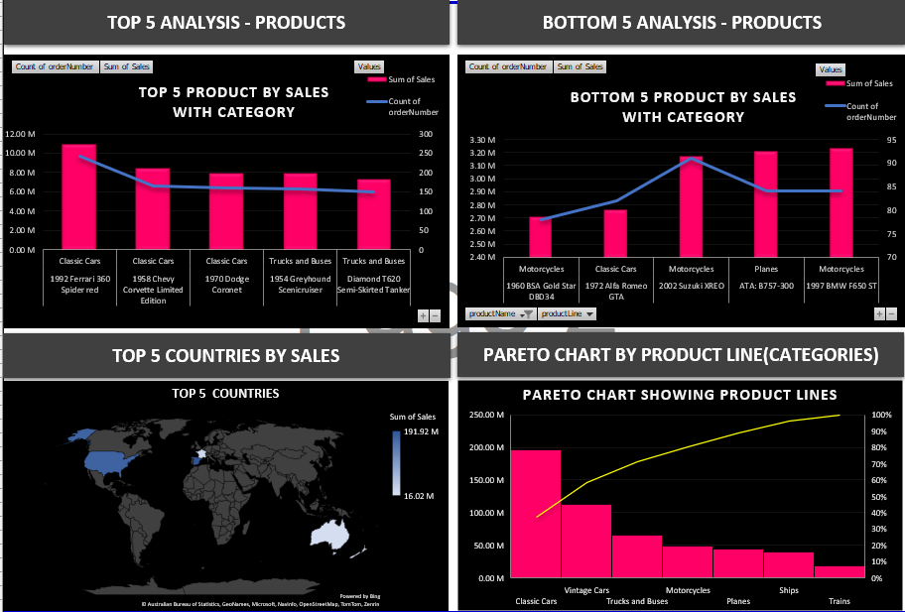
DASHBOARD (EXPLORATORY DATA ANALYSIS IN EXCEL)

Slide 50
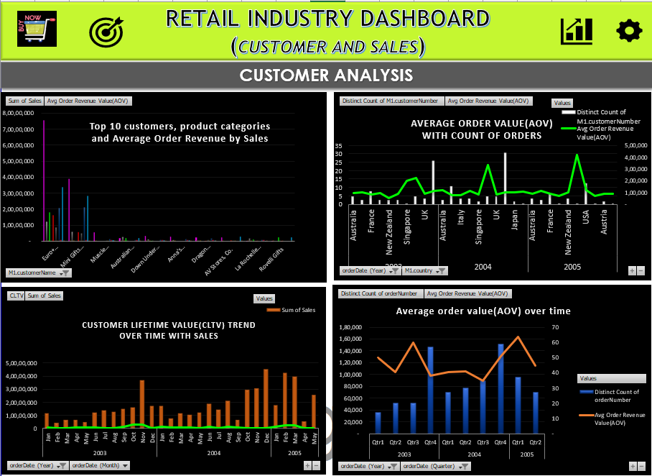
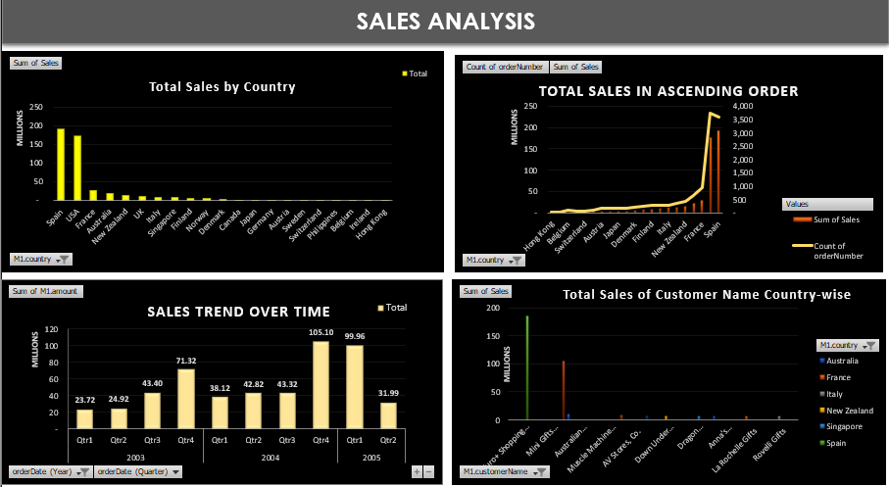
DASHBOARD (EXPLORATORY DATA ANALYSIS IN EXCEL)

Slide 51
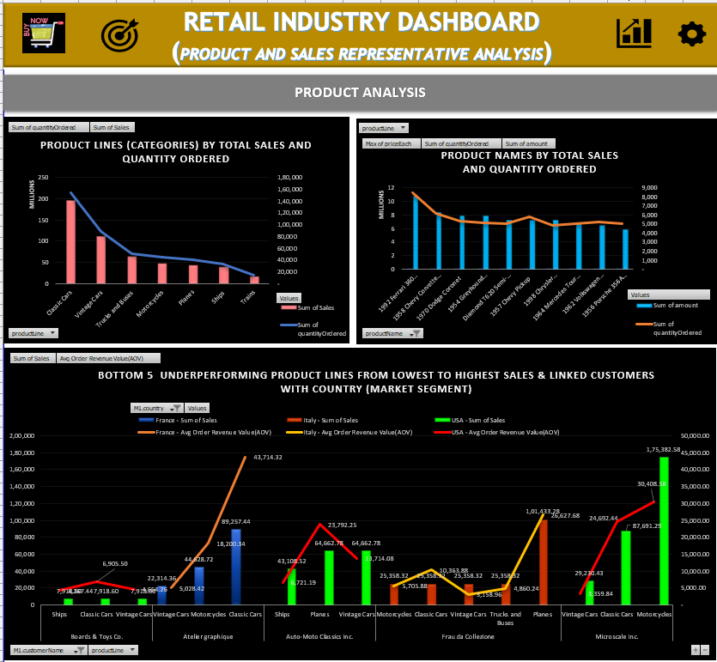
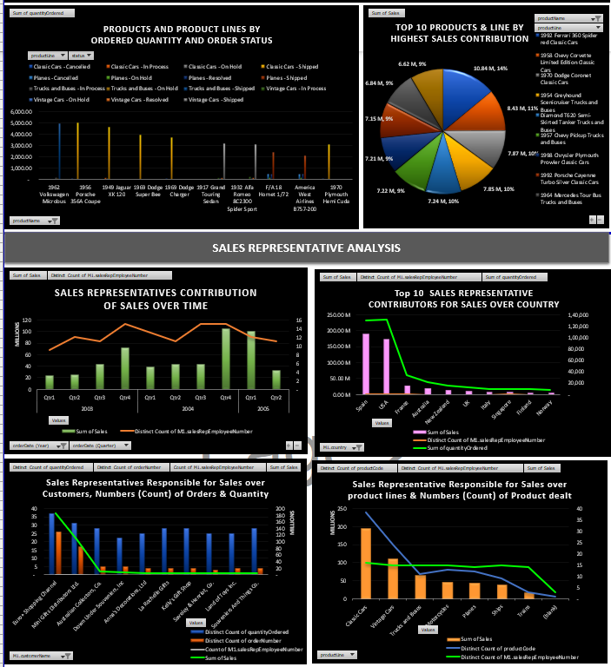
DASHBOARD (EXPLORATORY DATA ANALYSIS IN EXCEL)

Slide 52
CONCLUSION
Key Findings
After various analysis of data set, it shows retail stakeholders with actionable insights, enabling them to identify top-selling products, customer preferences, and target demographics. It has uncovered key findings related to the company's operations. Based on these findings, actionable recommendations have been provided to improve business operations and decision-making. Implementing these recommendations has the potential to have a significant impact on the retail company's performance and success.
Office with the highest sales
Top-performing employees
Most popular product lines
Seasonal order trends
Customer payment preferences

Slide 53
Recommendations
Expansion of company’s business to new territories is required
Offering training programs for employees
Marketing strategies for specific customer segments
Inventory management improvements
Payment method diversification
Focusing on Customer Lifetime Value (CLTV) as there is a declining trend
over years

